Slide 1
Docker – Basic Concepts and Advanced Topics
Foundation for Modern Apps
Amit Rathod
April 2021

Slide 2
Introduction
Introduction to Micro-service Architecture
Containers
Docker
Additional Information
Lab

Slide 3

Presentation and Playbook
Go grab a copy of the presentation and playbook to follow along
The playbook contains steps and commands we will be using
https://github.com/amitrathod101/docker-concepts/

Slide 4
Introduction to Micro-Service Architecture

Slide 5
What’s Wrong with Traditional Applications
A quick example
Everything is tied to a single codebase
When one change is made, the entire application has to change
Application
Web/App Server
Database
Operating System

Slide 6
Reasons to Switch to Micro-services
Micro-services is an architectural style in which applications are decomposed into loosely coupled services
Increased resilience
Improved scalability
The right tool for the right task
Faster time to market
Easier debugging and maintenance
Micro-service UI
Micro-service
Micro-service
Micro-service
Micro-service

Slide 7
Containers

Slide 8
What’s a Container?
Standard unit of software that packages up code and all of its dependencies
Containers help create a reproducible environment
You specify the exact version of:
Application
Different libraries
Different environment variables
Different configuration settings
Allow you to run your application in isolation inside that environment
Allows applications to run quickly and reliably from one computing environment to another
Core component in a micro-service architecture
Container
App A
App B
App C
Bins/Libs
Bins/Libs
Bins/Libs
Container Runtime
Host OS
Infrastructure

Slide 9
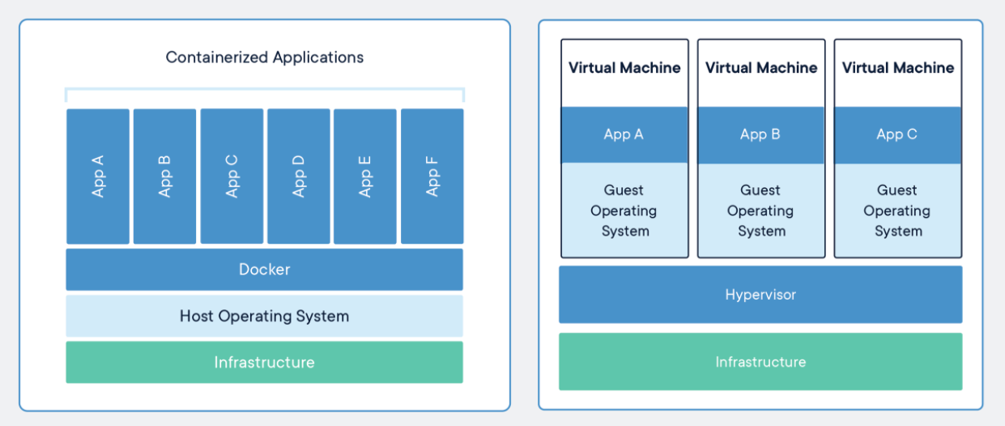
Containers vs VMs

Slide 10
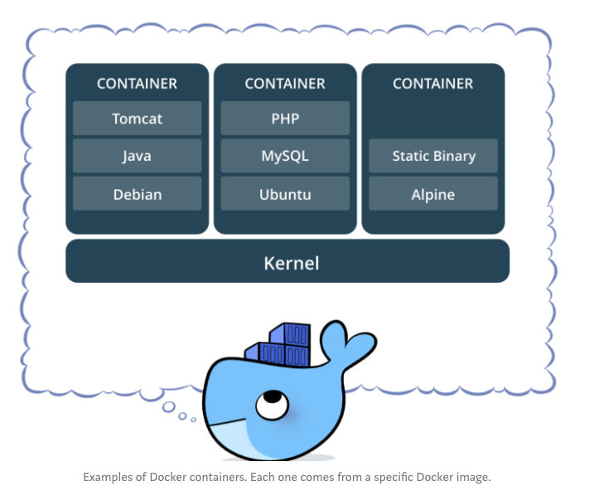
Container Examples

Slide 11
Docker

Slide 12
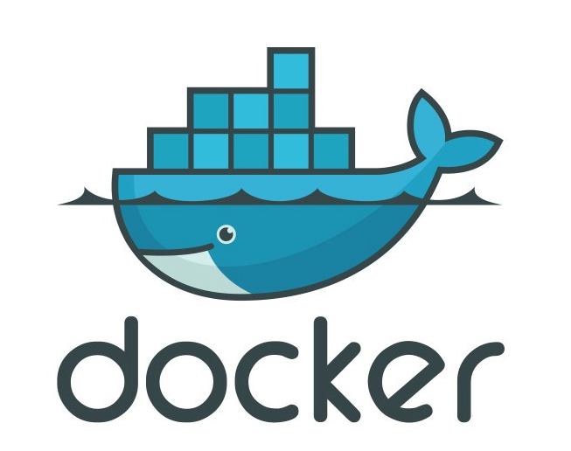
Docker Defined
Docker is a tool designed to make it easier to create, deploy and run applications using containers.

Slide 13


Docker Flow
Users
Container
Container
Docker Registry
App A
App B
Push Image
Bins/Libs
Bins/Libs
3
4
1
Docker Client
Start instance of image
Place screenshot here
API
Docker Runtime (dockerd)
2
Host OS
Version Control
Build Image
Infrastructure
Docker File for A
Docker File for B

Slide 14
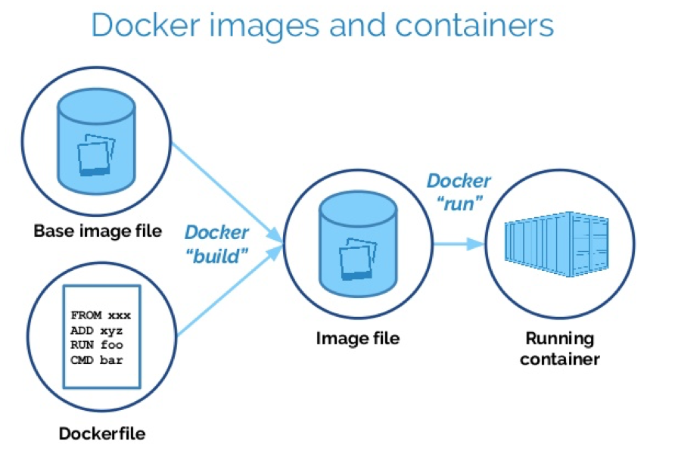
Basic Container Architecture with Docker
Images
Storage
Network
Plugins

Slide 15
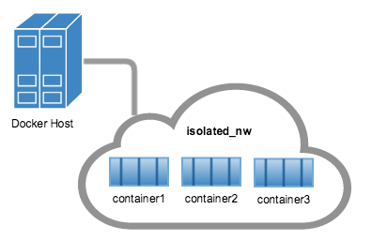
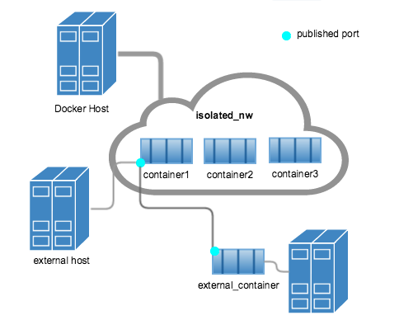
Docker Networks
Bridge
default, used in standalone container
Host
swarm, remove network isolation between container and docker host
Overlay
Overlay networks connect multiple Docker daemons together and enable swarm services to communicate with each other
Macvlan
allow you to assign a MAC address to a container, making it appear as a physical device on your network
None
disable all networking

Slide 16
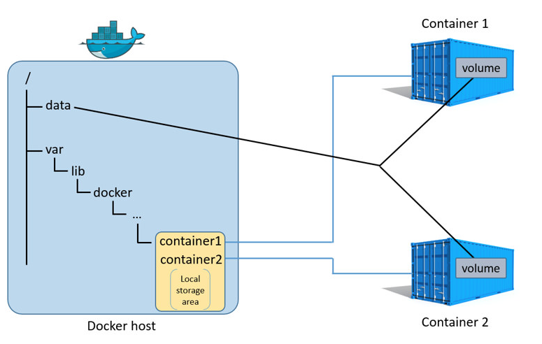
Docker Storage
Means of persistent storage
Otherwise everything we did goes away
Typical persistent data
Log files, databases, JSON files
Basic commands
docker volume create
docker volume ls
docker volume prune
docker volume rm
docker inspect [name of volume]
attach a volume to a container
docker run -d -p 8000:3000 --name my-container --volume my-volume:/xxx/yyy

Slide 17
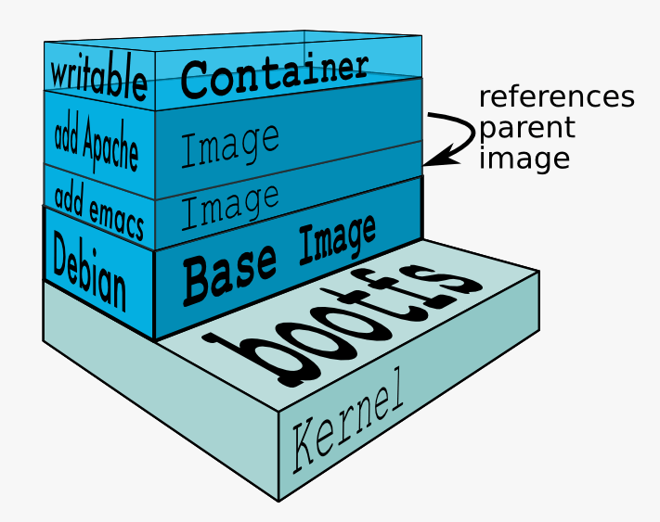
Images
Base Image
Layered Image
In the simplest form an image is a base filesystem
An image does not have a state
An image is a read-only template
Cannot be modified
You can build your own image or use images developed by others
Images are stored in a repository
Images can be based on multiple layers
Stacked on top of each other
Cannot run an image by itself

Slide 18
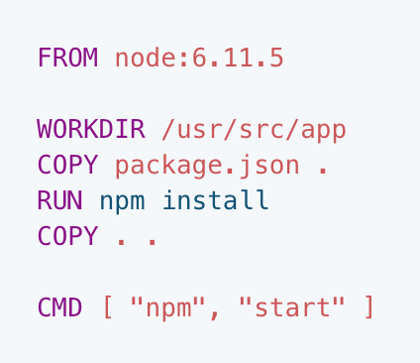
Dockerfile
Text document
Contains all commands to build an image
The docker build command reads the Dockerfile and uses that to build an image

Slide 19
Basic Docker Commands
docker run (-d daemon mode)
docker ps
docker stop/start {stop or start the container}
docker images {list images (and their repository)}
docker exec {run a cmd in a running container}
docker push/pull
docker rm {remove the container completely}
docker build {creates an image}

Slide 20
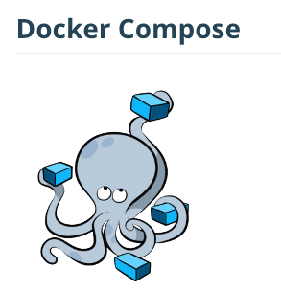
Docker Compose
Tool for defining and running multi-container docker applications
Manages the application life cycle
Start, stop, rebuild services
View the status of running services
Stream the log output of running services
Run a one off command
Build several images at once, start several containers

Slide 21
Docker Plugins
Out-of-process extensions that add capabilities to the docker engine
Run on the same or different host as the docker engine
Registers itself with Docker
Can run inside or outside containers (running outside is recommended)
Docker Plugin API
https://docs.docker.com/engine/extend/plugin_api/
Examples
IPAM
Network drivers
Authorization
Docker Engine
Container
App A
IPAM Plugin
Bins/Libs
IPAM

Slide 22
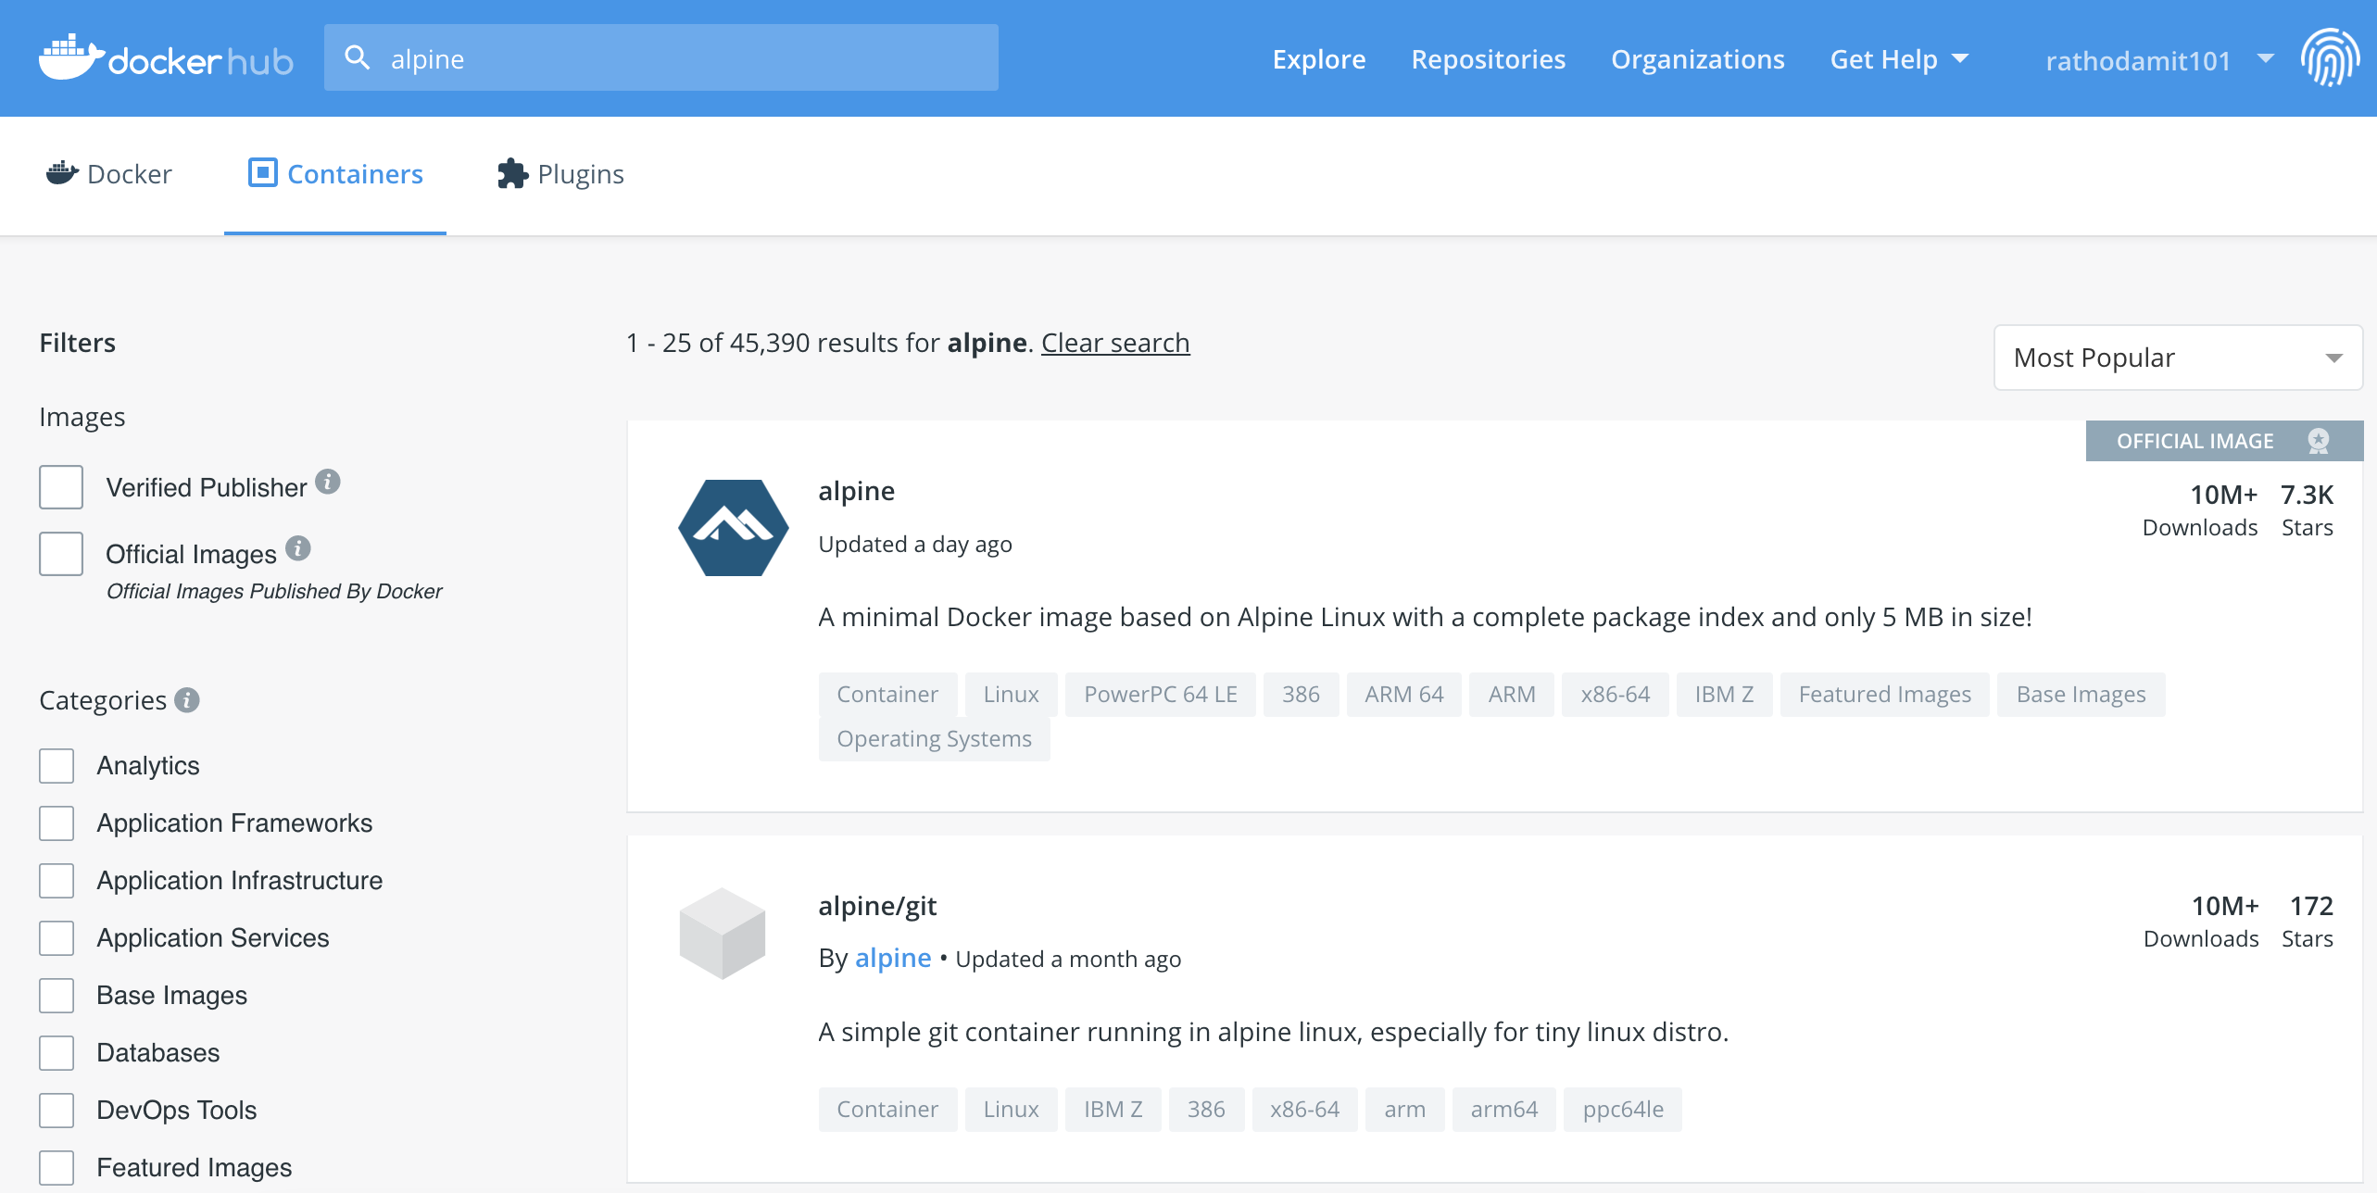
Examples of Base Images
From Docker Hub, GCR, ACR, Harbor, etc
Scratch – empty image
Alpine, BusyBox – simple linux images
Debian, Ubuntu, CentOS – more advanced linux images
Microsoft/servercore – windows server base image
Microsoft/nanocore – smaller footprint windows image

Slide 23
Example of building a basic image
% docker build –t hello .
% docker run hello
Dockerfile
FROM ubuntu:trusty
CMD [“/bin/ping”, “localhost” ]
“hello” Image
Running a command off the ubuntu container
ubuntu linux base image

Slide 24
Example adding a shell script to the hello image
% docker build –t hello .
% docker run hello
Dockerfile
FROM alpine:latest
COPY hello /
COPY compute.sh /
RUN chmod +x /compute.sh
#this is the cmd running the application
CMD [“/compute.sh”]
“hello” Image
Compute.sh from laptop
Excutable Hello App from laptop
Alpine Linux

Slide 25
Multi-level Dockerfile
% docker build –t hello .
% docker run hello
Dockerfile
FROM golang:1.14-buster AS build ENV GOPROXY= https://proxy.golang.org WORKDIR /go/src/ COPY . . RUN CGO_ENABLED=0 go build -o /go/bin/hello-from-container . FROM ubuntu:bionic RUN mkdir /hello COPY --from=build /go/bin/hello-from-container /hello/ USER nobody:nogroup CMD ["/bin/bash", "-c", "./hello/hello-from-container"]
“hello” Image
Executable Hello app
Secondary ubuntu image
Hello-app compiled in golang container
golang

Slide 26
Finally, Images vs Containers
Hello Image
% docker build –t hello .
- Creates a read-only template
- Can be based on multiple images/layers
- Cannot run by itself
Hello Container
% docker run hello
- runnable instance of an image
- creates a writeable layer
- adds compute, network, storage
“hello” Image
Hello Image
hello app
Docker Runtime
Secondary Scratch image
hello app compiled in golang
Compute
Network
Storage
golang

Slide 27
Docker Components
docker cli
dockerd
containerd
runC

Slide 28
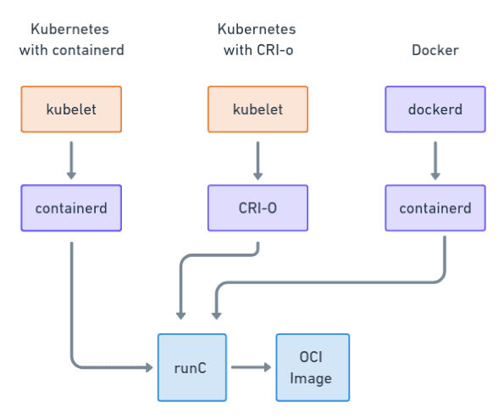
Container Runtime Formats
OCI is a runtime specification that describes how to unpack and run a container
runC is the OCI maintained implementation
OCI standard provides interoperability between container solutions
CRI
OCI Runtime

Slide 29
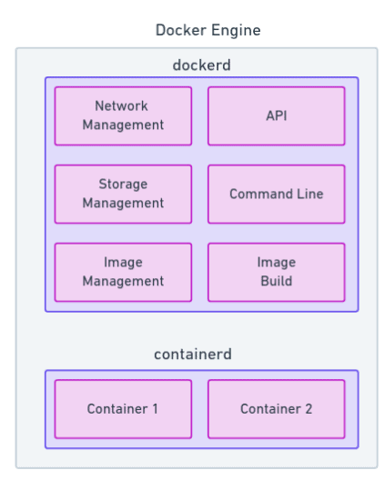
Docker Engine
containerd
- helps manage the containers which are run by runC
dockerd
- helps translate commands sent via the CLI all the way down to the containers.

Slide 30
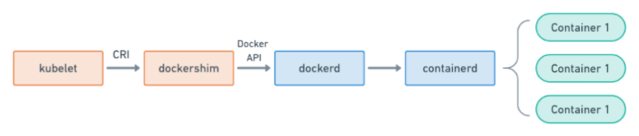
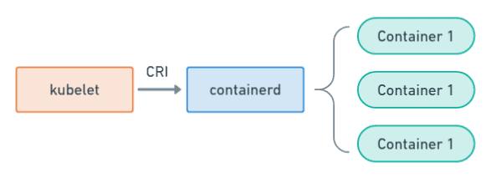
Dockershim Deprecation
Kubernetes is shifting away from Dockershim NOT docker
Kubernetes with Docker Shim (currently being deprecated
Kubernetes with containerd

Slide 31
A note on CPU and Memory utilization
Docker can be greedy…
Docker containers have full access to memory and cpu of the host
If you don’t limit cpu and memory, docker can use all the system resources
How to limit:
% docker run –memory=“1g” hello
% docker run –cpus=“1.0” hello
Show before and after:
% free –m
% df -h

Slide 32
Docker Volumes
Persistent Storage for Containers
Containers have a writeable layer
However, any data you write goes away when the container exits (including logs)
Solution: Create a volume on the host filesystem
% docker volume create my-vol
% docker volume ls
% docker volume rm my-vol
https://docs.docker.com/storage/

Slide 33
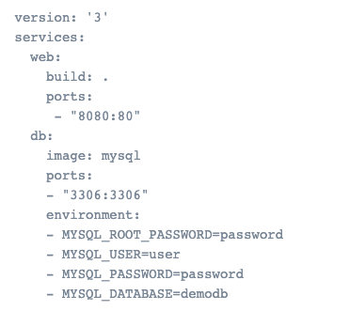
Dockerfile vs Docker Compose
Dockerfile
Simple text file
Contains commands to assemble an image
Docker Compose
YAML file (docker-compose.yml)
Defines and runs multi-container applications
Can call a Dockerfile or define everything in Compose
Configure, create and start all application services
https://docs.docker.com/compose/

Slide 34
Docker Swarm
Orchestration
Dockers version of cluster management and orchestration
Native to Docker
Provides tools for scaling, networking, securing and maintaining your apps

Slide 35
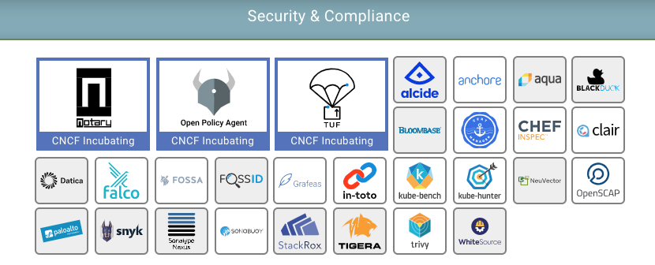
Security Concerns
Unsecured communication and unrestricted network traffic
Unrestricted access of process and files
Kernel level threats
Inconsistent update and patching of docker containers
Unverified docker images

Slide 36
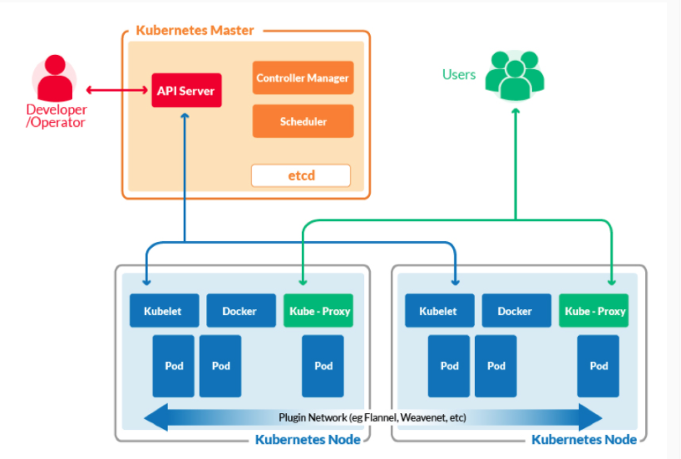
Docker vs Kubernetes
30 Second Intro to Kubernetes
Docker
Is an environment for running containerized applications on a single node
Kubernetes
Allows you to run containers across multiple compute nodes (VM or physical)
Allows you to automate container provisioning, networking, load-balancing, security and scaling across multiple nodes running Docker (or other container runtime)
Collection of nodes managed by a single Kubernetes instance is a Kubernetes Cluster

Slide 37
Product Example
Using Containers/Micro-Services

Slide 38
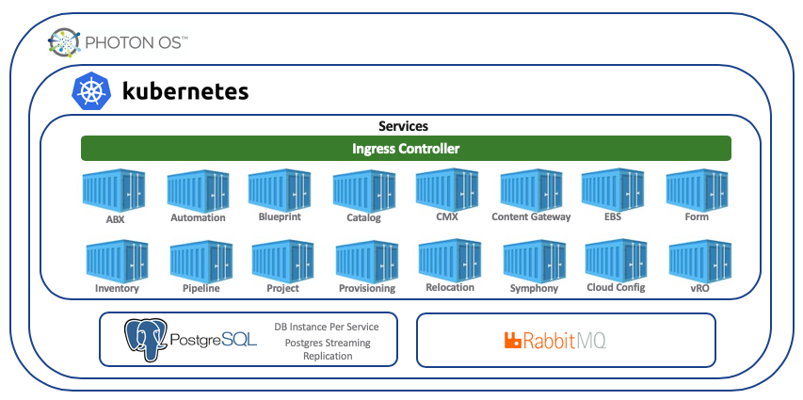
vRealize Automation 8.0

Slide 39
Additional Information

Slide 40
Information and Tutorials
Docker step-by-step tutorial
https://docs.docker.com/get-started/
https://linuxacademy.com/blog/docker/6-years-of-docker-hands-on-docker-training/
Cloud Native Computing Foundation
https://landscape.cncf.io/
Cloud Native Applications (CNABU)
https://confluence.eng.vmware.com/pages/viewpage.action?pageId=115976924
Docker & Compose Cheat Sheets
https://design.jboss.org/redhatdeveloper/marketing/dock
https://devhints.io/docker-composeer_cheatsheet/cheatsheet/images/docker_cheatsheet_r3v2.pdf

